Slide 1
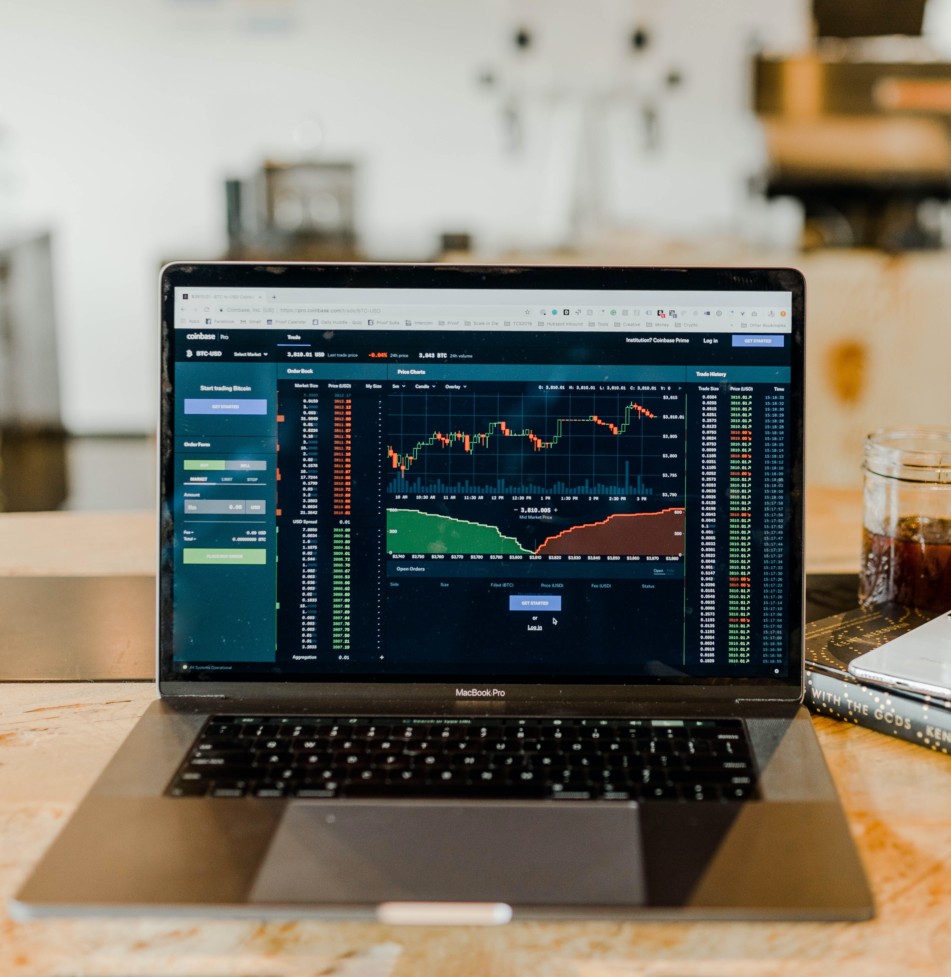
Stock market analysis
211153- rakshita Kaushik
211160-Hardik sangal

Slide 2
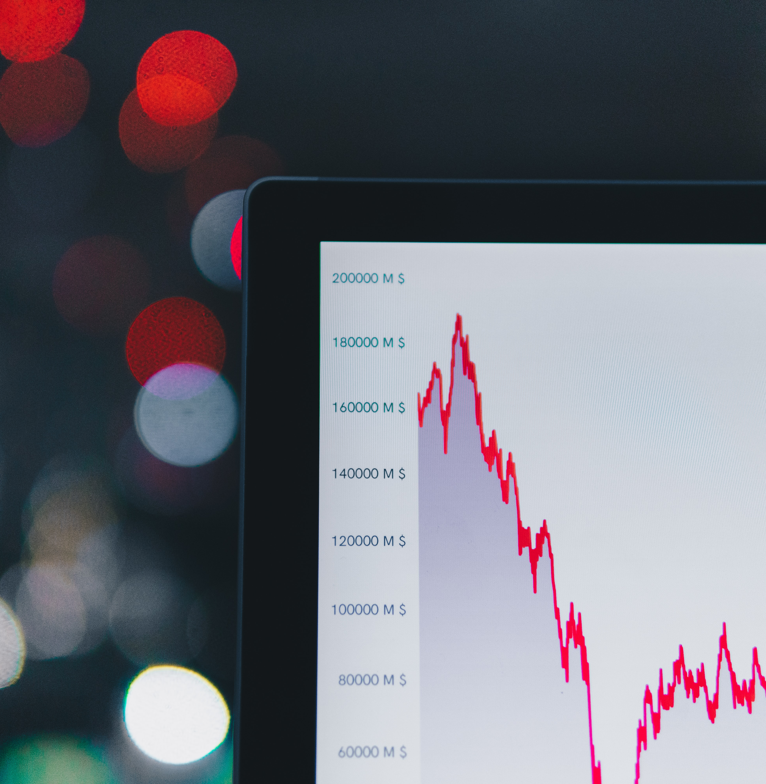
About Us
Our aim is to create software that analyzes previous stock data of certain companies, with help of certain parameters that affect stock value. We are going to implement these values in data mining algorithms. This will also help us to determine the values that particular stock will have in near future. We will determine the Month’s High , Low , Volume, Market cap, Daily percentage change .
We found a common intrest in stock market so we decided to analyze the stock of Google (GOOGL)

Slide 3
introduction
A stock is the small chunk of ownership in the company. The stock price of the company reflects the net evaluation of the company and also gives a little insight into its performance. These stocks are traded on exchanges and their prices are constantly changing due to their demand and supply in the market. If a stock is in high demand and low in supply i.e. more people want to buy it and fewer people are willing to sell it then the price for the stock will go up and similarly if the stock is in low demand and high on supply which means people more people are ready to sell it but fewer people are willing to buy it then its prices go down.

Slide 4
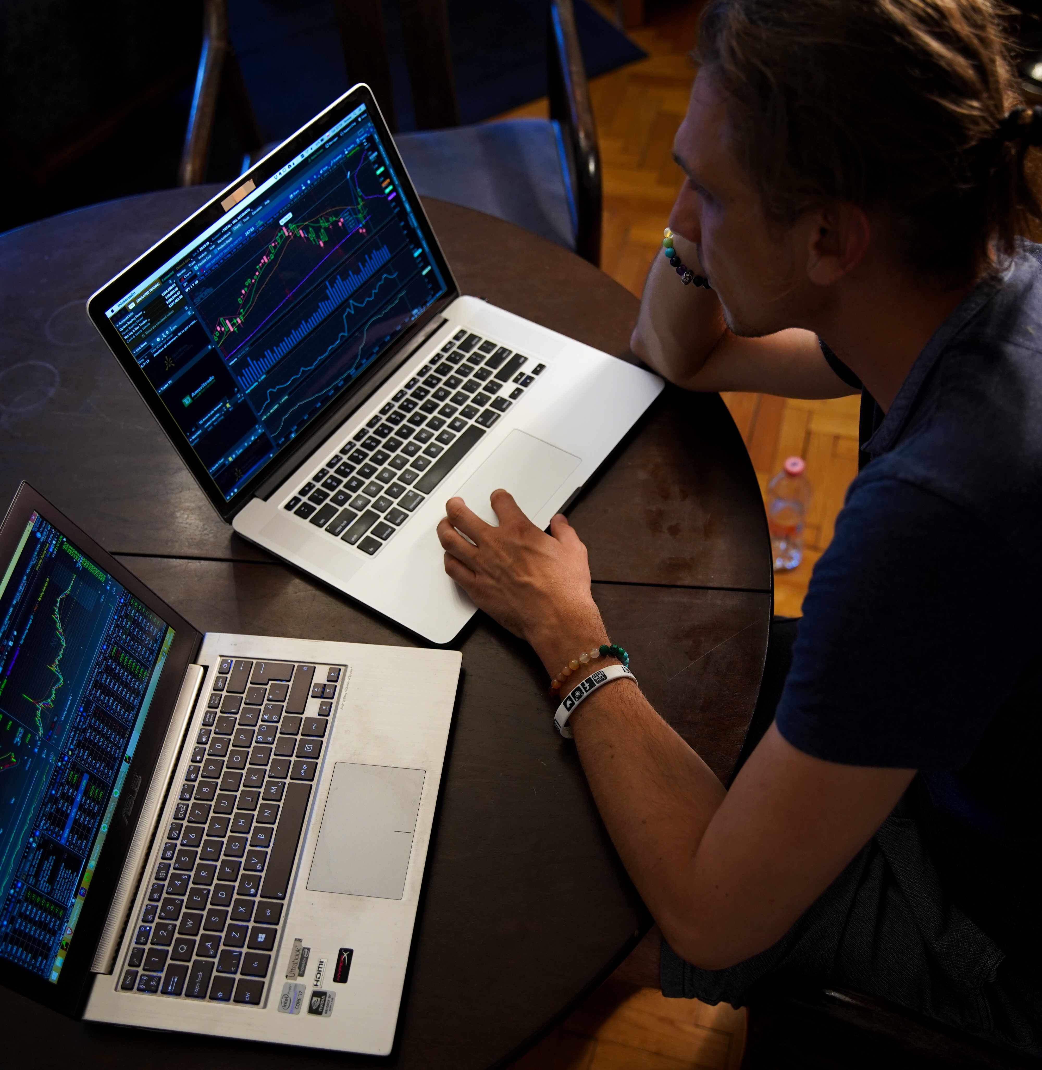

In this section we'll go over how to handle requesting stock information with pandas, and how to analyze basic attributes of a stock

Slide 5



Libraries used
Pandas_data readers
Date time
matplotlib
used to access public financial data from the Internet and import it into Python as a Data Frame.
In Python, date and time are not a data type of their own, but a module named datetime can be imported to work with the date as well as time
Matplotlib is a cross-platform, data visualization and graphical plotting library for Python and its numerical extension NumPy.

Slide 6
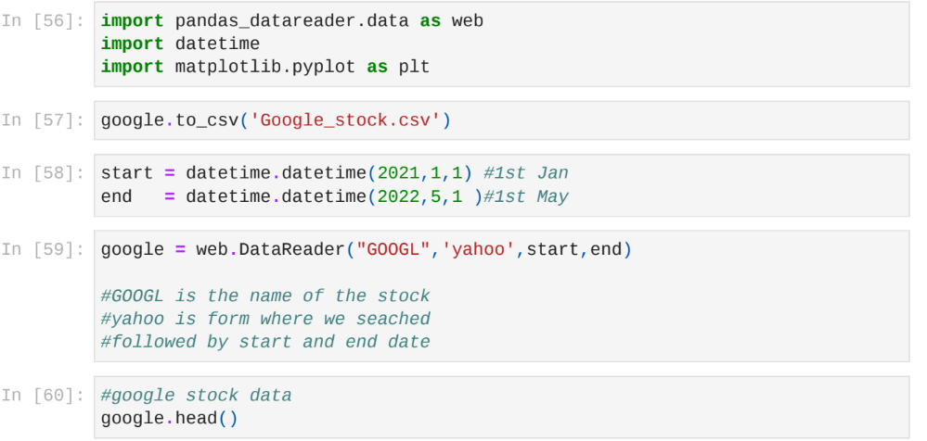
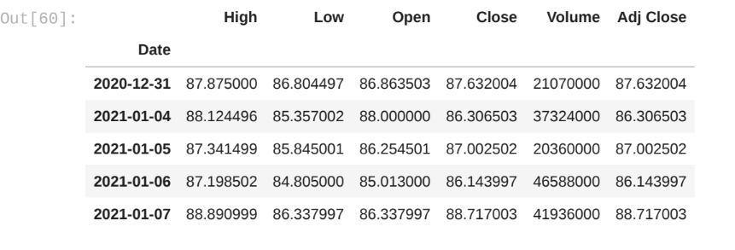
Importing pandas_datareader datetime matplotlib

Slide 7
Stock market visualisation
We have downloaded the daily stock prices data using pandas_reader. It’s a five-year data capturing Open, High, Low, Close, and Volume
Open: The price of the stock when the market opens in the morning
Close: The price of the stock when the market closed in the evening
High: Highest price the stock reached during that day
Low: Lowest price the stock is traded on that day
Volume: The total amount of stocks traded on that day

Slide 8
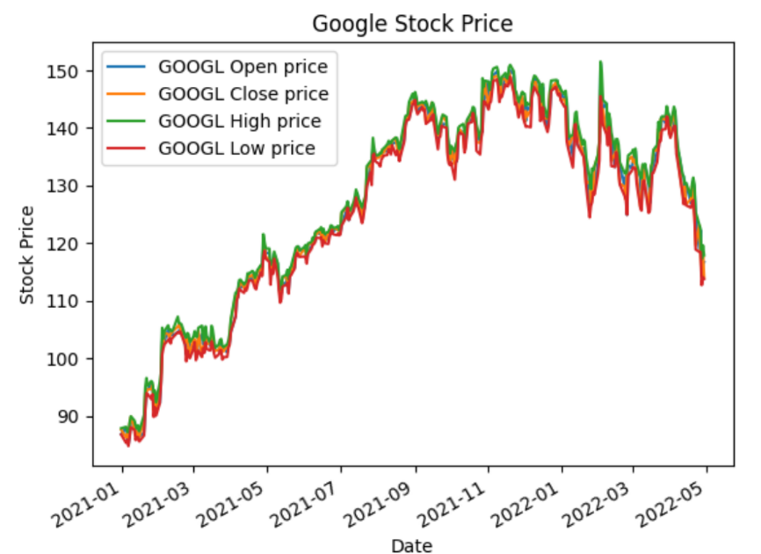
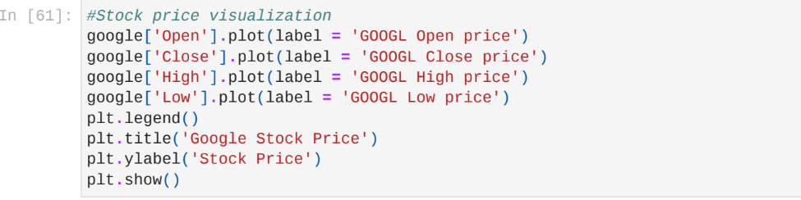

Slide 9
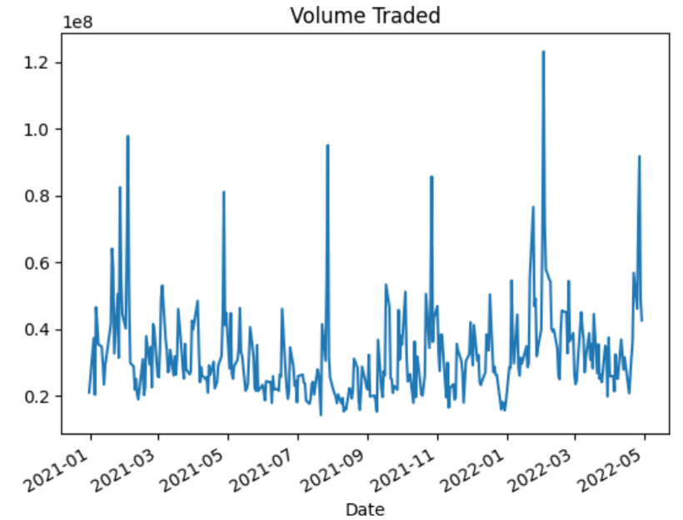
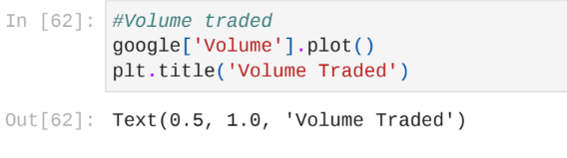
Volume traded
Now let’s plot the total volume of stock being traded
The Graph shows the volume traded by thiscompanies

Slide 10
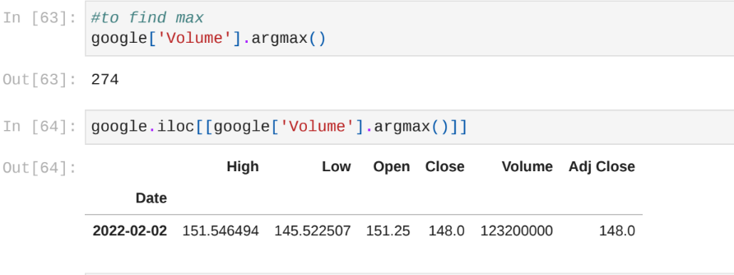
argmax

Slide 11
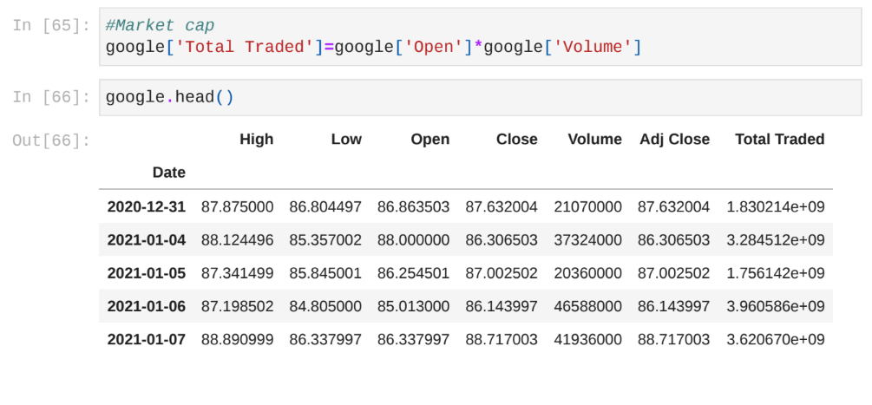
Market cap
Market capitalization, or market cap, is one measurement of a company's size. It's the total value of a company's outstanding shares of stock, which include publicly traded shares plus restricted shares held by company officers and insiders.

Slide 12
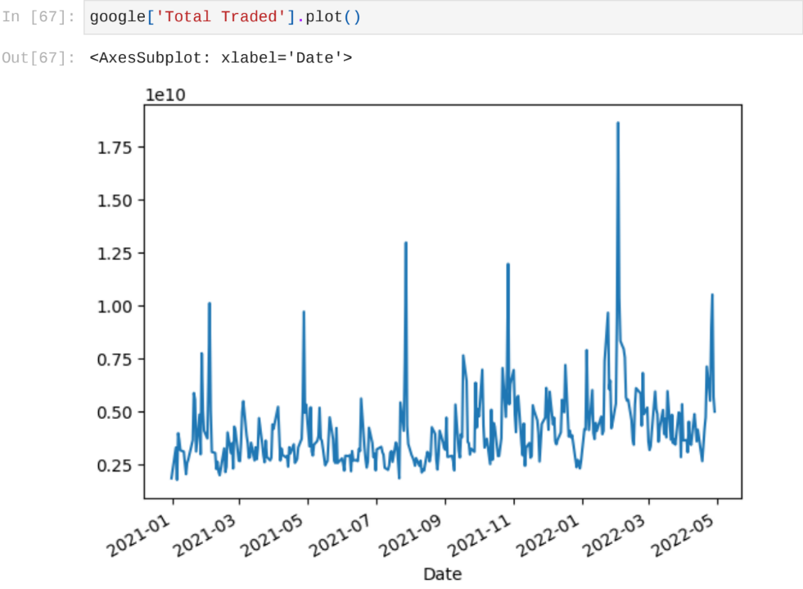
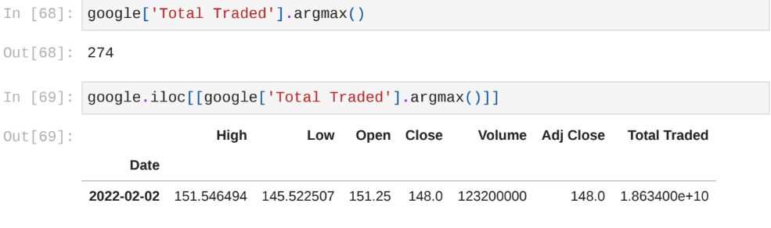

Slide 13
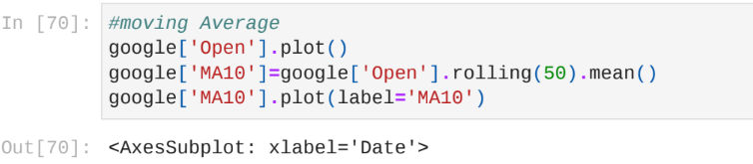
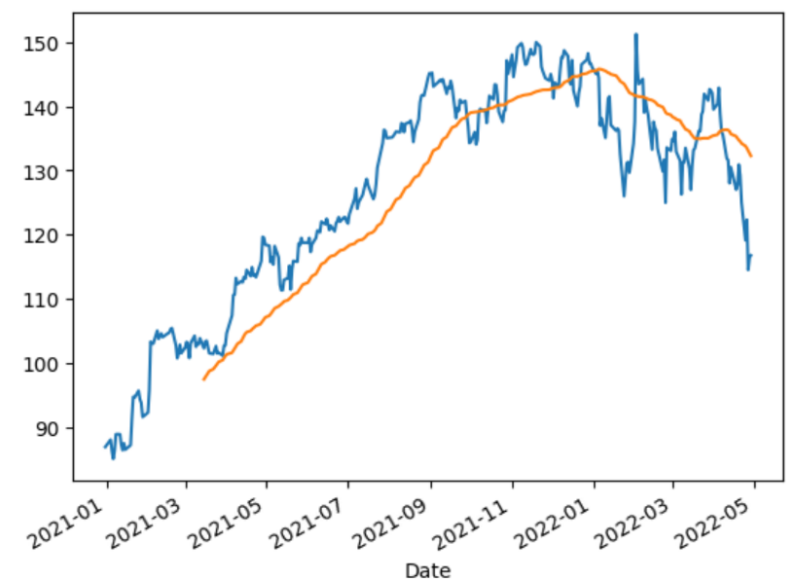
Moving average
A moving average (MA) is a stock indicator commonly used in technical analysis, used to help smooth out price data by creating a constantly updated average price . As we know the stock prices are highly volatile and prices change quickly with time. To observe any trend or pattern we can take the help of a 50-day 200-day average

Slide 14
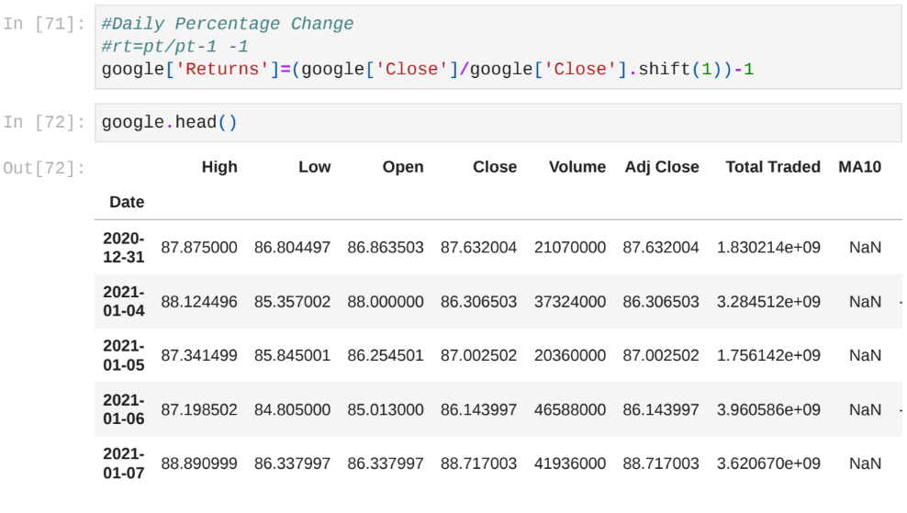
Daily percentage change
Now that we've done some baseline analysis, let's go ahead and dive a little deeper. We're now going to analyze the risk of the stock. In order to do so we'll need to take a closer look at the daily changes of the stock, and not just its absolute value. Let's go ahead and use pandas to retrieve teh daily returns for the google stock.

Slide 15
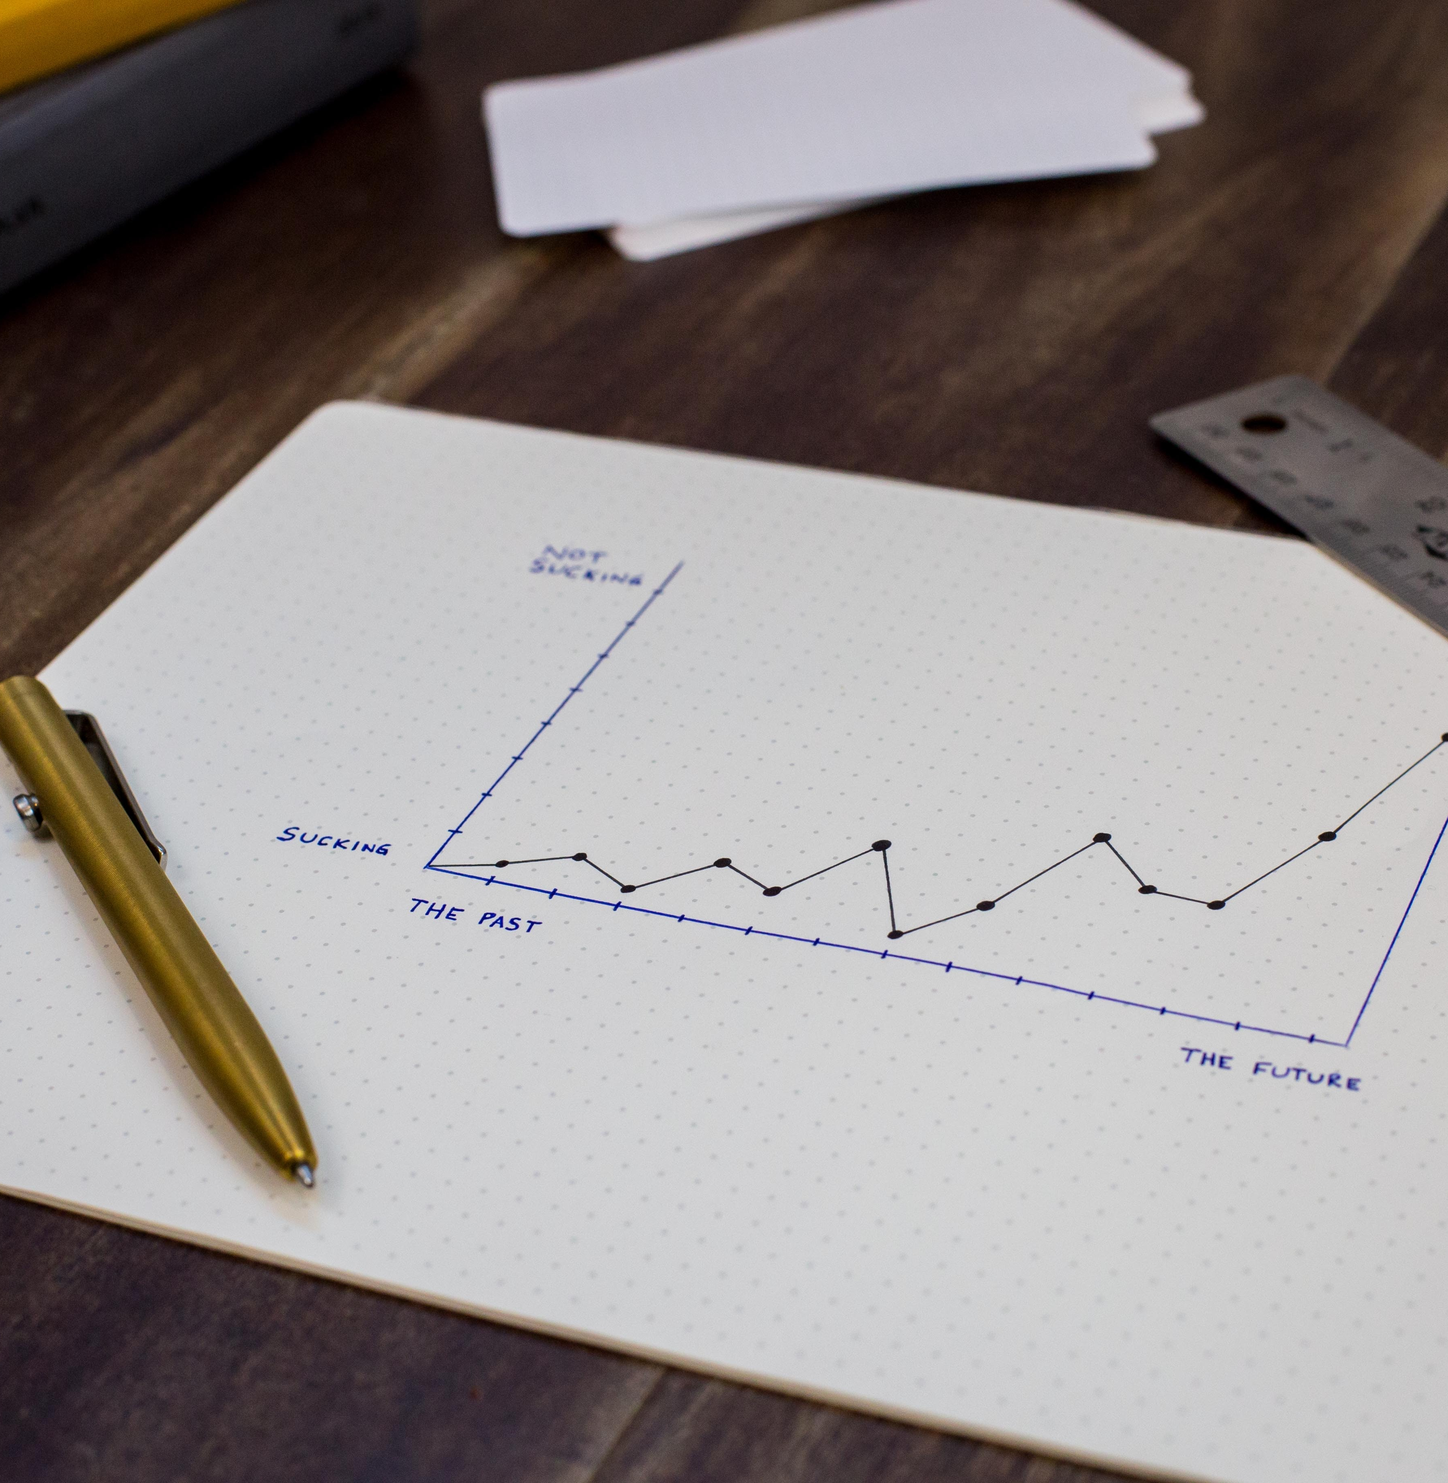
conclusion
The above analysis can be used to understand a stock’s short-term and long-term behaviour. A decision support system can be created which stock to pick from industry for low-risk low gain or high-risk high gain depending on the risk apatite of the investor.

Slide 16
Thank You

